Slide 1
Inheritance

Slide 2
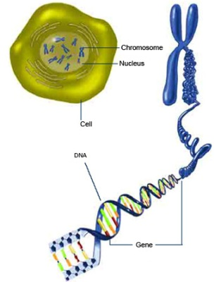
Chromosomes and genes

Slide 3
DNA
Chromosome – rod like structure in the nucleus that carry the hereditary information
Gene – have a specific location on a chromosome (locus) and are linked to a characteristic. As talked about earlier in the course – code for a protein. There are a number of alternative forms or codes that exist for each gene.

Slide 4
DNA
Allele – the different forms of a gene. An individual will usually have two alleles for the one gene. The alleles an individual has are inherited from their parents.

Slide 5
Meiosis review
Formation of gametes. The gamete contains just one allele for each gene. The amount of genetic material in the daughter cell is halved.
In reproduction, when two gametes come together they each provide one allele for each gene resulting in a total of two alleles in the offspring, one from the mother and one from the father.

Slide 6
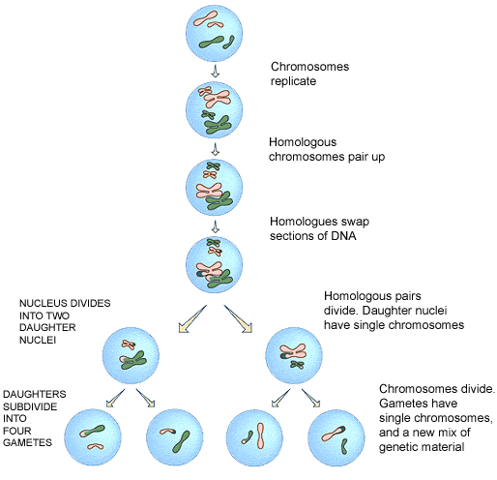
Meiosis

Slide 7
Review of inheritance
Dominant allele – this allele is expressed and masks/prevents the expression of other alleles
Recessive allele – will not be expressed in the presence of another allele
Co-dominance – both alleles are expressed in an individual.

Slide 8
Review of inheritance
Homozygous – an individual has the same two alleles for a given trait. Also called pure-breeding.
Heterozygous – an individual has two different alleles for a given trait. Also called a hybrid.
Phenotype – the physical trait that can be observed.
Genotype – genetic make-up of an individual – the alleles an individual has.

Slide 9
Multiple alleles
When there are more than two alleles for a given locus on a chromosome.
This results in more than two possible phenotypes and genotypes (Polymorphism)
An example is the ABO blood groups.
Three alleles I^{A}, I^{B} and i.
The A, and B refer to the antigen that the blood produces. “i” does not produce an antigen

Slide 10
ABO blood groups
The alleles I^{A} and I^{B} are co-dominant. An individual with the genotype I^{A}, I^{B} (heterozygous) will produce both the A and B antigen.
The “i” allele is recessive. The O blood group is when no antigens are formed. The individual is homozygous for the “i” allele.

Slide 11
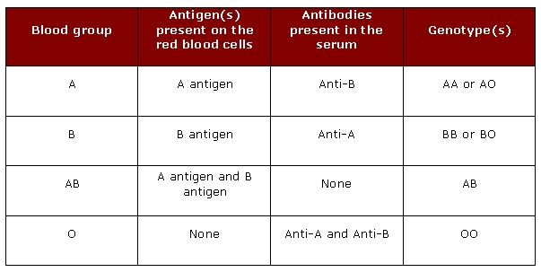
Summary of blood group genotypes and phenotypes

Slide 12
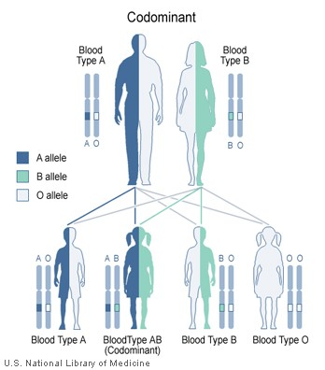

Slide 13
Polygenic inheritance
Monogenic inheritance: discrete characteristic coded by one pair of alleles at a certain locus.
Polygenic inheritance: characteristic coded by many pairs of alleles at a variety of loci. In this case individuals in a population will exhibit continuous variation.

Slide 14
Polygenic inheritance
The alleles at different loci do not form dominant/recessive relationships. They each have similar influence. They operate in an additive relationship on a scale with two ends.
Skin colour
  Dark -----------------------------------Light
Height
  Tall----------------------------------------Short

Slide 15
Polygenic inheritance
If skin colour has 5 alleles:
A capitalised letter refers to darker skin – more melanin being produced.
AABBCCDDEE: dark skin
AaBBCCDDEE: a little lighter
AaBbCcDdEe: ‘middle range’
aabbccddee: fair skin

Slide 16
Polygenic inheritance
If height has 5 alleles:
A capitalised letter refers to an increase in height – additive
AABBCCDDEE: tall
AaBBCCDDEE: tall
AaBbCcDdEe: average
aabbccddee: short

Slide 17
Polygenic inheritance
Both height and skin colour have more than five loci and as a result these characteristics have a continuous range of possibilities.
A second factor that causes variety is the effect that the environment has on phenotype (gene expression)

Slide 18
Environmental effect on skin colour
Skin colour is determined by the amount of melanin – this yellow/black pigment is produced in melanocytes.
All humans contain approximately the same number of melanocytes. An individual with darker skin has larger melanocytes, which contain more melanin and these melanocytes are more evenly distributed.

Slide 19
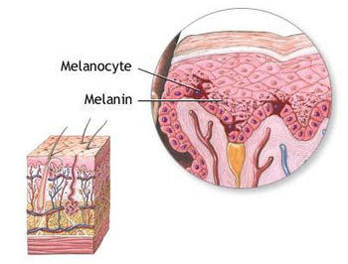
A Melanocyte

Slide 20
Environmental effect on skin colour
Exposure to Ultraviolet (UV) light stimulates the production of melanin. If an individual has few or none of the enzyme that controls this process they will have fair skin. Remember an enzyme is a protein (product of a gene).
This needs to be considered in hand with the genetic variation. Both factors produce greater variation within the population.

Slide 21
Environmental effects on height and weight
Diet – deficiencies in essential proteins and minerals may cause a person to not achieve their height potential.
Dietary excesses – lead to an increase in weight to a larger extent than what one would predict from a family background. Excess carbohydrates and fats are stored in adipose tissue.

Slide 22
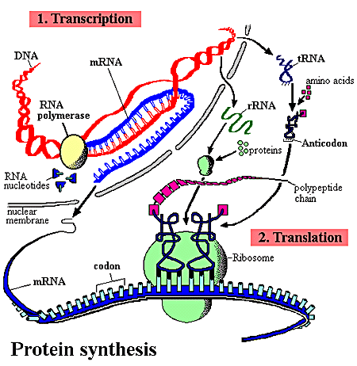
Review of protein synthesis

Slide 23
Control of gene expression
A gene is ‘switched on’: being used to make mRNA.
A gene is ‘switched off’: not being used to make mRNA.
Numerous environmental factors effect the expression of a gene. E.g. age of cell, time of day, signals from other cells, the external environment, stage of the cell division cycle.

Slide 24
Control of gene expression
Promoter – specific sequence of bases that the mRNA polymerase binds to (beginning transcription)
Regulator gene – will bind to the promoter to inhibit transcription.

Slide 25
Control of gene expression
The expression of the gene will alter the phenotype of an individual. Two genetically identical individuals will demonstrate some phenotypic differences – due to differences in expression – which can relate back to environment.
This variation is said to be due to Epigenetic factors (beyond genetics).

Slide 26
Epigenetic factors
“epi-” means ‘beyond’ or ‘on top of’
These are factors that play a key role in inheritance that are not to be found coded in DNA
Epigenetics is about turning genes on or off. It is about stable cellular memory that persists after cell division and, in some cases, even through sexual reproduction.

Slide 27
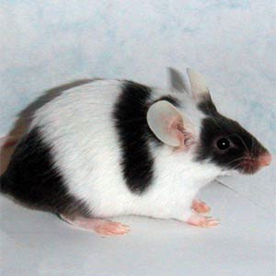
Epigenetics
All parts of the mouse have the gene that can make black fur but the blackness only occurs in some places.

Slide 28
Epigenetics – mechanisms
One epigenetic mechanism concerns chemical modifications of particular genes – typically the marking of certain genes with methyl groups (-CH₃).
The methyl groups are either attached to the DNA itself – this mostly leads to silencing of the gene – or to proteins that coat the DNA, called histones.
The patterns of marks can be stable over time and the DNA marks at least can be replicated, so epigenetic states can affect parts of the organism for life or can even cross generations.

Slide 29
Epigenetics - mechanisms
Acetylation (-COCH₃)is thought to have the opposite effect – by enhancing gene expression.
Epigenetic mechanisms are capable of being passed on from one cell generation to the next (mitosis). They are also capable of being passed on from parent to child.

